Slide 1
Choose Ohio First Scholarship Program 2016
Michael Strezeski, COFSP Recipient
RET Grant #: EEC-1404766

Slide 2
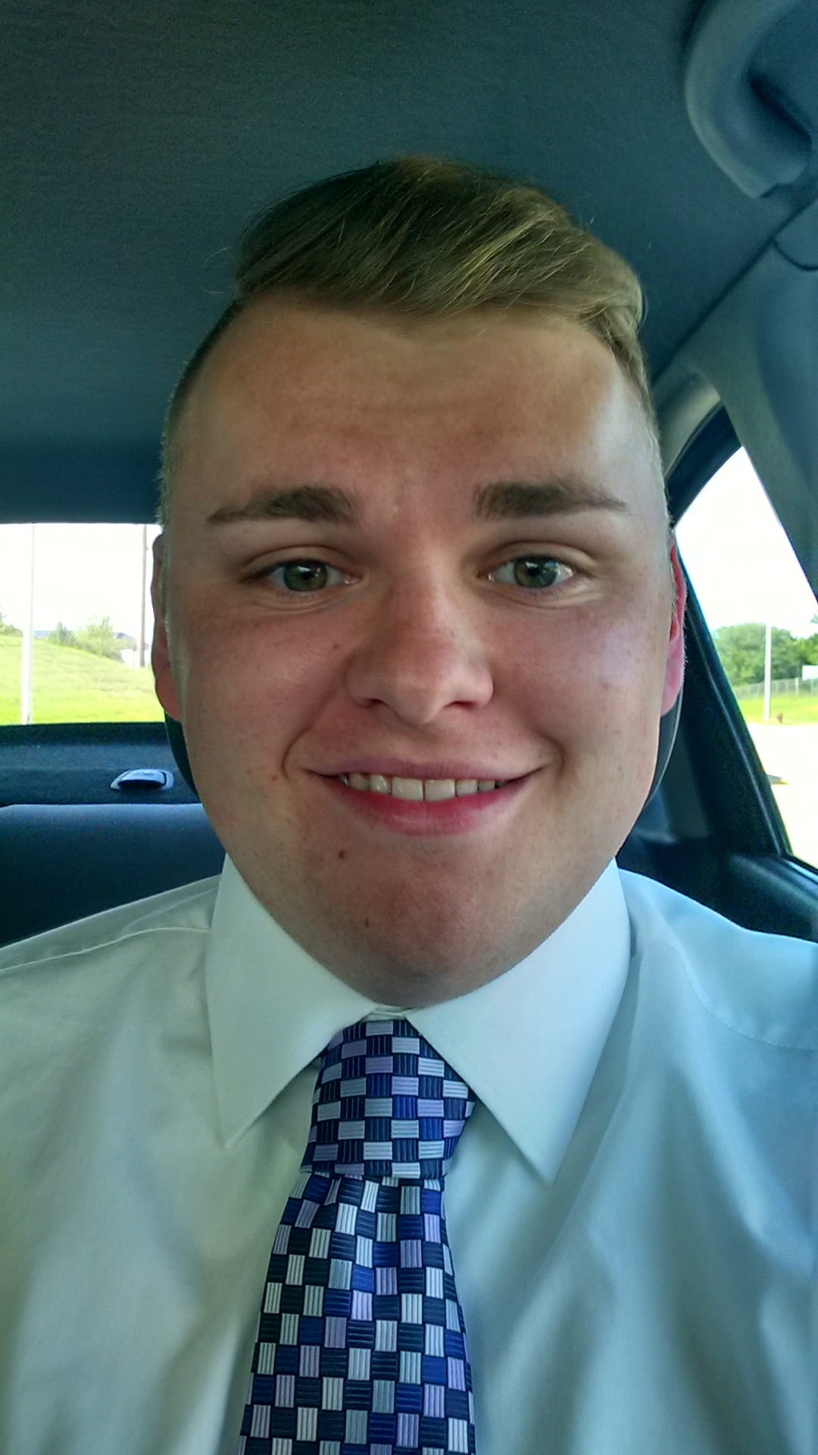
Introductions
Michael Strezeski
Senior – Chemical Engineering
COFSP Recipient 2015/2016
School: Newport Middle School
RET Teacher: Dustin Hinson
Class: 8th Grade Mathematics

Slide 3
Unit Topic and Objectives
Topic: Scientific Notation
Common Core State Standards (CCSS) – Mathematics
Make Sense of problems and persevere in solving them
Reason abstractly and quantitatively

Slide 4
Activity Highlights
Title: The 6 W’s of Scientific Notation
Activity Objectives:
The student will be able to:
Express numbers as a single digit times an integer power of 10.
Use scientific notation to estimate very large and/or very small quantities.
Compare quantities to express how much larger one is compared to another.
Guiding Questions:
How does multiplying by a power of 10 affect the value?
What is scientific notation?
How can a number be changed from standard to scientific notation?
How is scientific notation used in the “real world”?

Slide 5
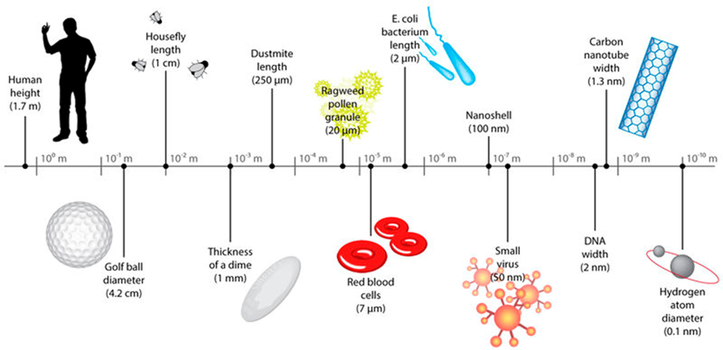
A.C.S.
Lesson was focused around real world applications (A), career awareness (C) and Societal Impact (S).
Real world applications: Students came to understand the need for scientific notation by comparison with texting abbreviations (LOL, etc.) Students came up with examples and applications of other places where it could be implemented.
EDP used to explain societal impact and career awareness

Slide 6
Results

Slide 7
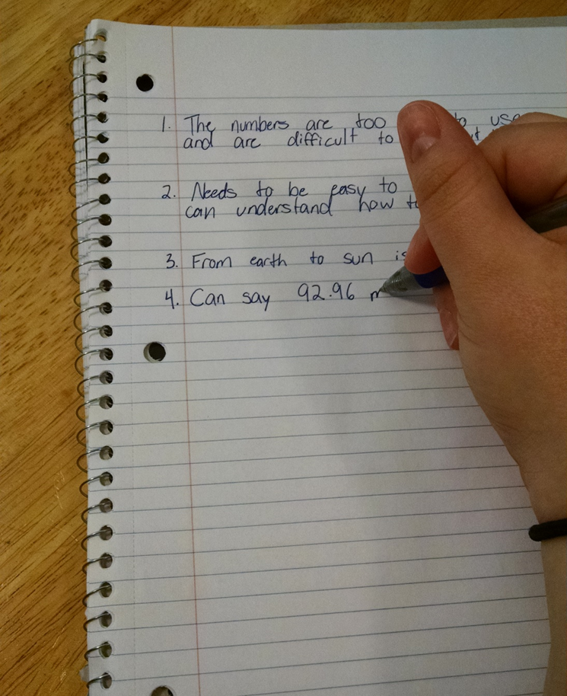
Activities
Used EDP step by step to show students the societal impact and social awareness of the topic. Students attempted to develop their own notation for large or small numbers.
Played a short ‘basketball’ game to increase student’s interest in lesson and act as a formative assessment.

Slide 9
Reflections
Students responded very well to activities and to real-world applications of the concept. Average test scores improved 24% after lesson.
Some things that could be done to improve are:
Changing some of the assessment questions for clarity
Use accelerated student’s knowledge to help the rest of the class catch up

